Slide 1
PRESENTATIO Of JAVA Basic DataTypes Grpoup1: 1. LENG MOUYHONG 2. LUN TOLA 3. CHHON CHINA 4.HONG KIMMENG 5. HOK KIMLEANG

Slide 2

CONTENTS OF THIS TOPICE
Topic cover: Basic Datatypes a. Primitive Datatypes b. Reference Datatypes c. Java Literals

Slide 3
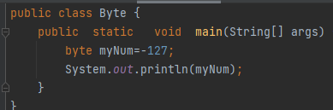
Primitive Datatypes
Primitive Datatypes: In Java, the primitive data types are the predefined data types of Java. They specify the size and type of any standard values. Java has 8 primitive data types namely byte, short, int, long, float, double, char and Boolean.
Byte : This can be used instead of int or other integer types to save memory when you are certain that the value will be within -128 and 127.
Example code:

Slide 4
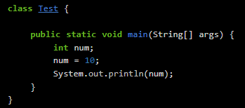
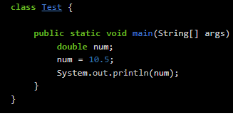
Int: The int data type is used to store integers. Integers are numbers which don’t have decimal.
. Double:
The double data type is used to store double-precision 64-bit floating point numbers. Floating point numbers are numbers which have decimal.

Slide 5
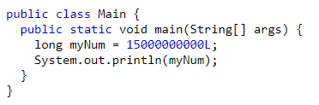
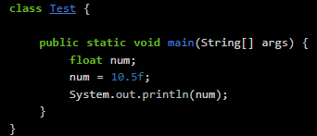
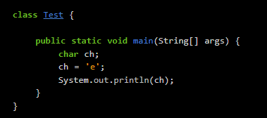
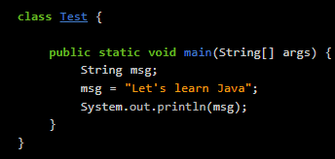
Long : The Java long keyword is a primitive data type. It is used to declare variables. It can also be used with methods. It can hold a 64-bit two's complement integer.
Float:
The float data type is used to store single-precision 32-bit floating point numbers. A float value should always end with f or F.
Char:
The char data type is used to store a character. A character value must be written within single quotes ‘ ‘.
String
The String data type is used to store a string. A string is a sequence of characters.

Slide 6
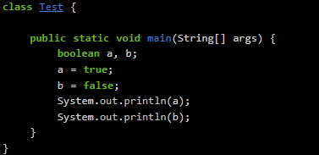
boolean
The boolean data type consists of two values - true and false.

Slide 7
reference data type in java
Reference variable is used to point object/values. 2. Classes, interfaces, arrays, enumerations, and, annotations are reference types in Java. Reference variables hold the objects/values of reference types in Java.
Non-primitive data types are called reference types because they refer to objects.

Slide 8
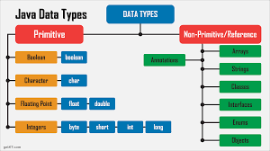
For example non primitive or reference data type is :
.class :It is a set of instructions. It describes the content of the object.
.Arrays :It provides the fixed-size data structure that stores the elements of the same type.
.String: a string is an object that represents a number of character values.
.Interface: an abstract type that is used to describe a behavior that classes must implement.
.Enums: a special data type that enables for a variable to be a set of predefined constants.
.objects: a member (also called an instance) of a Java class.

Slide 9
Literals in Java
Literal: Any constant value which can be assigned to the variable is called literal/constant.
In simple words, Literals in Java is a synthetic representation of boolean, numeric, character, or string data. It is a medium of expressing particular values in the program, such as an integer variable named “/counted is assigned an integer value in the following statement.Literals in Java have:
+ Integral literals + Char literals as Integral literals
- Decimal literals - Unicode Representation
- Octal - Escape Sequence
- Hexa-decimal - String
- Binary literals - Boolean
+ Floating-Point literals
+ Char literals

Slide 10
Integral literals: For integral data types (byte,short,int,long) we can specify literals in 4 ways:
-Decimal literals (Base10): In this form, the allowed digits are 0-9.-Octal literals (Base 8): In this form, the allowed digits are 0-7.The octal number should be prefix with 0. Example: int x=0512;
-Hexa-decimal literals (Base 16): In this form, the allowed digits are 0-9, and characters are a-f.We can both uppercase and lowercase characters as we know that java is a case-sensitive programming language, but here java is not case-sensitive.
The hexa-decimal number should be prefix with 0X or ox. Example x = 0X123Face;-Binary literals: Form 1.7 onward, we can specify literal value even in binary form also, allowed digits are 0 and 1. Literals value should be prefixed with 0b or 0B. Example: int x = 0b1111;Floating-Point literals: For Floating-Point data types, we can specify literals in only decimal form, and we can't specify in octal and hexadecimal forms.
-Decimal literals (Base 10): In this form, the allowed digits are 0-9.

Slide 11
